Slide 1
Linear Algebra
Lecture 40

Slide 2
Linear Algebra
Lecture 40

Slide 3
Segment VI
Orthogonality and
Least Squares

Slide 4
Orthogonal
Projections

Slide 5
Orthogonal Projection
The orthogonal projection of a point in R² onto a line through the origin has an important analogue in R^{n}.
…

Slide 6

Continued
Given a vector y and a subspace W in R^{n}, there is a vector in W such that
(1) is the unique vector in W for which y – is orthogonal to W, and
(2) is the unique vector in W closest to y.
…

Slide 7




Continued
Figure
…

Slide 8
Continued
We observe that whenever a vector y is written as a linear combination of vectors u₁, …, u_{n} in a basis of R^{n}, the terms in the sum for y can be grouped into two parts so that y can be written as y = z₁ + z₂
…

Slide 9
Continued
where z₁ is a linear combination of some of the u_{i}, and z₂ is a linear combination of the rest of the u_{i}.
This idea is particularly useful when {u₁,…, u_{n}} is an orthogonal basis.

Slide 10
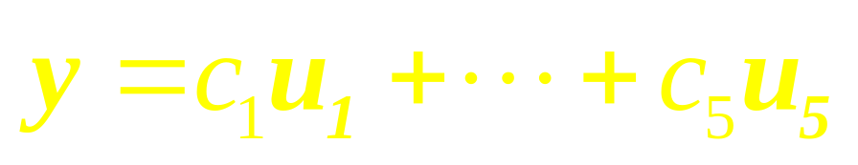

Example 1
Let {u₁, …, u₅} be an orthogonal basis for R⁵ and let
Consider the subspace W = Span {u₁, u₂}, and write y as the sum of a vector z₁ in W and a vector z₂ in .

Slide 11
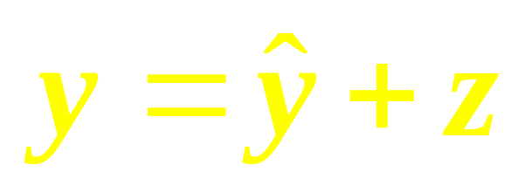

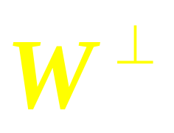
The Orthogonal
Decomposition Theorem
Let W be a subspace of R^{n}. Then each y in R^{n} can be written uniquely in the form
where is in W and z is in .
…

Slide 12
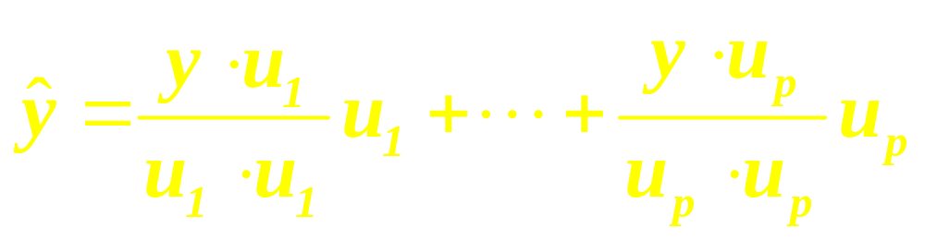

Continued
In fact, if {u₁, …, u_{p}} is any orthogonal basis of W, then
and z = y – . The vector is called the orthogonal projection of y onto W and often is written as proj_{w} y.

Slide 13
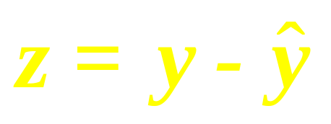


Continued
Orthogonal Projection
of y on to W.

Slide 14
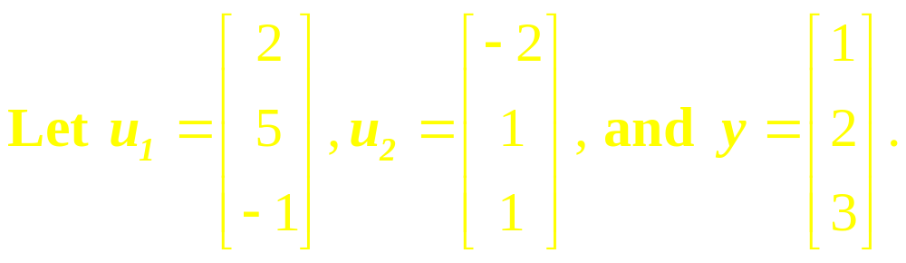
Example 2
Observe that {u₁, u₂} is an orthogonal basis for W = Span {u₁, u₂}. Write y as the sum of a vector in W and a vector orthogonal to W.

Slide 15

Best Approximation
Theorem
Let W be a subspace of R^{n}, y any vector in R^{n}, and the orthogonal projection of y onto W. Then is the closest point in W to y, in the sense that for all v in W distinct from .
…

Slide 16
Continued
The vector in this theorem is called the best approximation to y by elements of W.

Slide 17
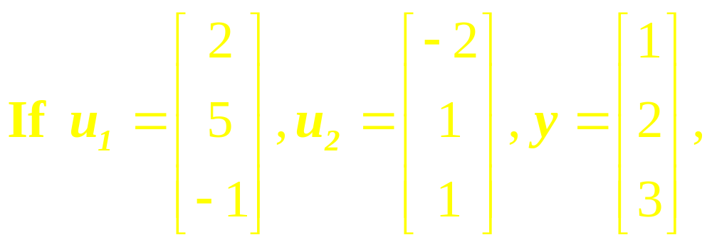
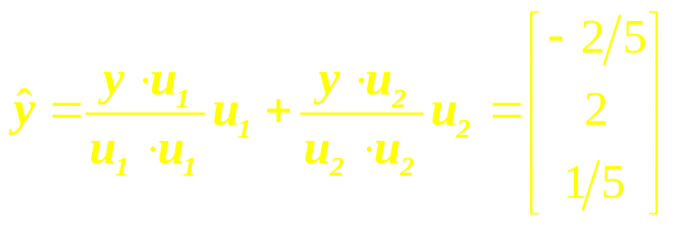
Example 3
and W = Span {u₁, u₂}, then the closest point in W to y is

Slide 18
Example 4
The distance from a point y in R^{n} to a subspace W is defined as the distance from y to the nearest point in W.
…

Slide 19
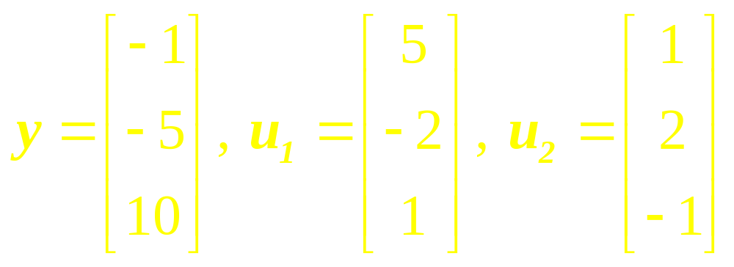
Continued
Find the distance from y to W = Span{u₁, u₂}, where

Slide 20
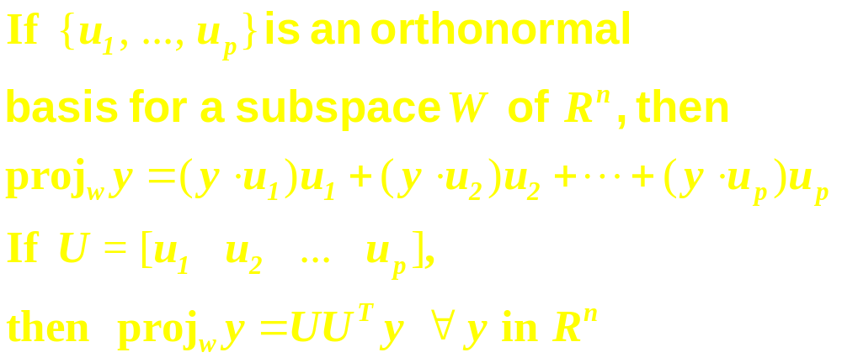
Theorem

Slide 21
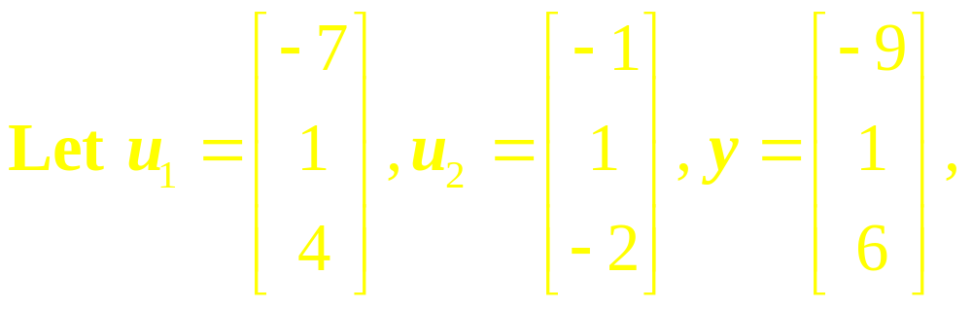
Example 5
and W = Span{u₁, u₂}. Use the fact that u₁ and u₂ are orthogonal to compute proj_{w} y.

Slide 22
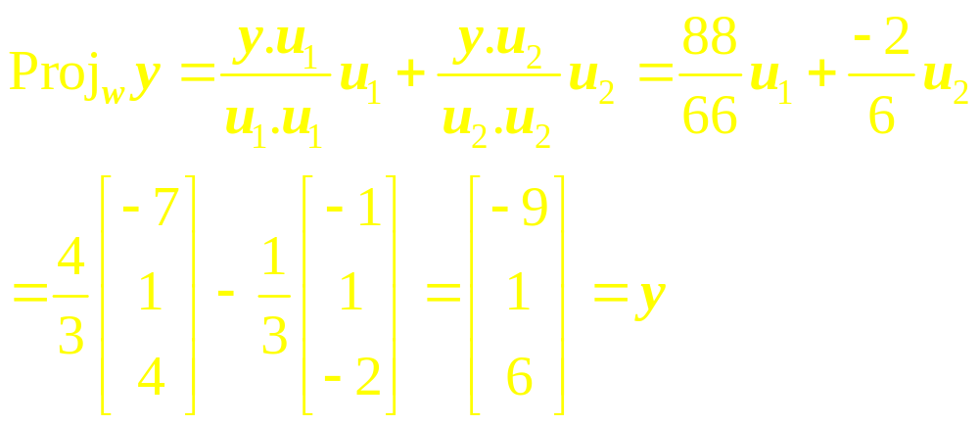
Solution
In this case y happens to be a linear combination of u₁ and u₂, so y is in W. The closest point in W to y is y itself.

Slide 23
Linear Algebra
Lecture 40

